Slide 1

Data Structures
Module Number: 04
Module Name: Non-linear Data Structures-Trees
Version: DSA3
Released Date : 24-SEP-2018

Slide 2
Non-linear Data Structures-Trees
AIM
To Equip students the concept of linked data structure that may have multiple relations among its nodes.

Slide 3
Non-linear Data Structures-Trees
Objective of This Module
The Objectives of this module are:
To be able to explain about non–linear data structure.
To understand the concept of tree data structure.
To be able to explain about variations of trees and its applications.

Slide 4
Non-linear Data Structures-Trees
Outcome
At the end of this module, you are expected to:
Learn about trees as a non-linear data structure
Understand the binary tree data structure and its application
Learn about AVL trees and its height balance properties

Slide 5
Non-linear Data Structures-Trees
Contents
General Trees
Binary Tree And Its Operations
Tree Representation
Conversion From General Trees To Binary Trees
Application Of Trees
AVL Trees And Rotations

Slide 6
Non-linear Data Structures-Trees
GENERAL TREES

Slide 7
Non-linear Data Structures-Trees
Classification Of Data Structure
Linear Data Structure
Array
Linked List
Stack
Queue
Non Liner Data Structure
Tree
Graph

Slide 8
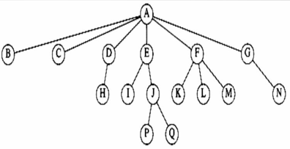
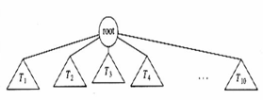
Non-linear Data Structures-Trees
What is Tree?
Recursive definition, a tree is a collection of n nodes, one of which is the root, and n – 1 edges
Having n - 1 edges follows from the fact that each edge connects some node to its parent, and every node except the root has one parent.

Slide 9
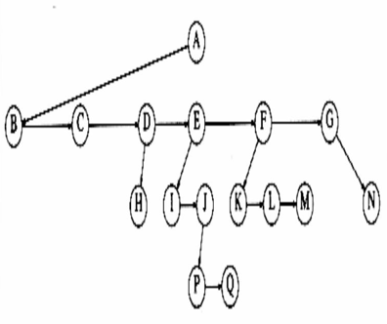
Non-linear Data Structures-Trees
General Tree
A tree can be represented as
Arrows that point downward are first_child pointers
Arrows that go left to right are next_sibling pointers

Slide 10
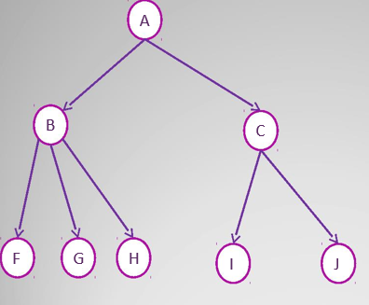
Non-linear Data Structures-Trees
Trees
A connected structure which
Is either empty OR
has a designated node called root, from which descends 0, 1 or more subtrees which are also Trees.

Slide 11
Non-linear Data Structures-Trees
Terminologies
Finite number of elements called nodes, finite set of directed lines called branches that connect the nodes.
Branch directed towards a node is an In-degree Branch.
Branch directed away from the node is Out-degree Branch.
The node with out-degree Zero (0) is known as leaf or a terminal node.
Sum of number of In-degree and Out-degree node branches = degree of node.
If Tree is not empty the first node is called as root.
Nodes that are neither root nor a leaf are known as Internal.

Slide 12
Non-linear Data Structures-Trees
Node that has subtrees is the parent of the roots of the subtrees.
Roots of these subtrees are children of the Node.
Children of the Same Parent are Siblings.
Ancestors of a node are all the nodes along the path from the root to node
Path is a sequence of nodes in which each node is adjacent to the next one
Level of a node is the distance from the root
Root is at Level – 0
Height (depth) of the Tree is the level of the leaf in the longest path from the root

Slide 13
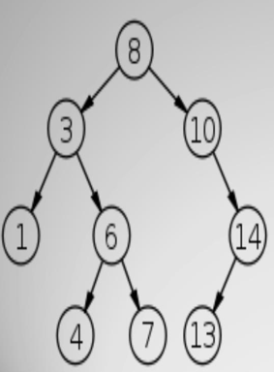
Non-linear Data Structures-Trees
Example of a Tree
No. of nodes = 9
Height = 4
Highest Level = 3
Root Node = 8
Leaves = 1, 4, 7, 13
Interior Nodes = 3, 10, 6, 14
Ancestors Of 6 = 3, 8
Descendants Of 10 = 14, 13
Sibling Of 1 = 6

Slide 14
Linked Lists
Self Assessment Question
1. Root is at ___________ level.
-1
0
1
2
Answer: b)
Notes:
1. b)

Slide 15
Linked Lists
2. _________________ is an example of Non-Linear data structure.
Stack
Queue
Tree
Array
Answer: c)
Notes:
2. c)

Slide 16
Linked Lists
3. Trees follows a hierarchical structure. State whether true or false.
True
False
Answer: a)
Notes:
3. a)

Slide 17
Non-linear Data Structures-Trees
Document Links
Topics | URL | Notes
General Trees | http://www.cs.cmu.edu/~clo/www/CMU/DataStructures/Lessons/lesson4_1.htm | Include notes on General trees

Slide 18
Non-linear Data Structures-Trees
Video Links
Topics | URL | Notes
Introduction to trees | https://www.youtube.com/watch?v=qH6yxkw0u78 | This video explains about tree data structure.

Slide 19
Non-linear Data Structures-Trees
BINARY TREE AND ITS OPERATIONS

Slide 20
Non-linear Data Structures-Trees
Binary Trees
A finite set of vertices that is either
Empty OR
Consists of a root node together with two binary subtree which are disjoint from each other, and from the root and are called the left and right subtree
Maximum no. of nodes at any level i is 2i
Maximum no. of nodes at height h is 2h-1
Height =Level + 1
Log2(n+1) < height <= 2h-1

Slide 21
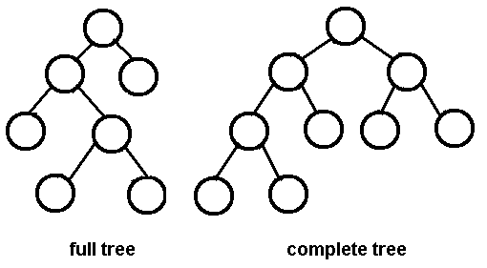
Non-linear Data Structures-Trees
Full Binary Tree and Complete Binary Tree
Full Binary Tree: A Binary Tree is full if every node has 0 or 2 children
A Binary Tree is a complete Binary Tree if all levels are completely filled except possibly the last level and the last level has all keys as left as possible

Slide 22
Non-linear Data Structures-Trees
Binary Tree Traversal Methods
Preorder
In-order
Post-order
Level order

Slide 23
Non-linear Data Structures-Trees
Preorder Traversal
void preOrder(treePointer ptr)
{
if (ptr != NULL)
{
visit(t);
preOrder(ptr->leftChild);
preOrder(ptr->rightChild);
}
}

Slide 24
Non-linear Data Structures-Trees
Preorder Example (Visit = print)
a
b
c
a
b
c

Slide 25
Non-linear Data Structures-Trees
a
b
c
f
d
e
g
j
h
i
a
b
d
g
h
e
c
f
j
Notes:
During the traversal, t starts at the root, moves to the left child b of the root, then to the left child d of b. When the traversal of the left subtree of b is complete, t, once again, points to the node b. The t moves into the right subtree of b. When the traversal of this right subtree is complete, t again points to b. Following this, t points to a. We see that t points to every node in the binary tree three times – once when you get to the node from its parent (or in the case of the root, t is initially at the root), once when you return from the left subtree of the node, and once when you return from the node’s right subtree. Of these three times that t points to a node, the node is visited the first time.

Slide 26
Non-linear Data Structures-Trees
/
*
+
e
f
+
-
a
b
c
d
/
*
+
a
b
-
c
d
+
e
f
Gives prefix form of expression!

Slide 27
Non-linear Data Structures-Trees
Inorder Traversal
void inOrder(treePointer ptr)
{
if (ptr != NULL)
{
inOrder(ptr->leftChild);
visit(ptr);
inOrder(ptr->rightChild);
}
}

Slide 28
Non-linear Data Structures-Trees
Inorder Example (Visit = print)
a
b
c
b
a
c

Slide 29
Non-linear Data Structures-Trees
a
b
c
f
d
e
g
j
h
i
g
d
h
b
e
i
a
f
j
c

Slide 30
Non-linear Data Structures-Trees
Inorder By Projection (Squishing)
a
b
c
f
d
e
g
j
h
i
g
d
h
b
e
i
a
f
j
c

Slide 31
Non-linear Data Structures-Trees
Inorder Of Expression Tree
/
*
+
e
f
+
-
a
b
c
d
a
+
b
*
c
-
d
/
e
+
f
Gives infix form of expression (sans parentheses)!

Slide 32
Non-linear Data Structures-Trees
Postorder Traversal
void postOrder(treePointer ptr)
{
if (ptr != NULL)
{
postOrder(ptr->leftChild);
postOrder(ptr->rightChild);
visit(t);
}
}

Slide 33
Non-linear Data Structures-Trees
Postorder Example (Visit = print)
a
b
c
b
c
a

Slide 34
Non-linear Data Structures-Trees
a
b
c
f
d
e
g
j
h
i
g
h
d
i
e
b
j
f
c
a

Slide 35
Non-linear Data Structures-Trees
Postorder Of Expression Tree
/
*
+
e
f
+
-
a
b
c
d
a
b
+
c
d
-
*
e
f
+
/
Gives postfix form of expression!

Slide 36
Non-linear Data Structures-Trees
Traversal Applications
Make a clone.
Determine height.
Determine number of nodes.
a
b
c
f
d
e
g
j
h
i
Notes:
Make a clone using postorder traversal. Clone the left subtree, clone the right subtree, clone the root in the visit step.
Determine height using postorder traversal … determine the height of the left subtree, determine the height of the right subtree, in the visit step add 1 to the max of the already determined heights of the left and right subtrees.
Determine number of nodes using preorder, inorder, or postorder traversal … initialize a counter to 0, add 1 to the counter in the visit step.

Slide 37
Non-linear Data Structures-Trees
Level Order
Let ptr be a pointer to the tree root.
while (ptr != NULL)
{
visit node pointed at by ptr and put its children on a FIFO queue;
if FIFO queue is empty,
set ptr = NULL;
else
delete a node from the FIFO queue and call it ptr;
}

Slide 38
Non-linear Data Structures-Trees
Level-Order Example (Visit = print)
a
b
c
f
d
e
g
j
h
i
a
b
c
d
e
f
g
h
i
j

Slide 39
Non-linear Data Structures-Trees
Self Assessment Question
1. Binary trees can have how many children?
2
any number of children
0 or 1 or 2
0 or 1
Answer: c)
Notes:
1. c)

Slide 40
Non-linear Data Structures-Trees
2. The number of external nodes in a full binary tree with n internal nodes is ___.
n
n+1
2n
2n + 1
Answer: b)
Notes:
2. b)

Slide 41
Non-linear Data Structures-Trees
3. Which of the following statement about binary tree is CORRECT?
Every binary tree is either complete or full
Every complete binary tree is also a full binary tree
Every full binary tree is also a complete binary tree
A binary tree cannot be both complete and full
Answer: c)
Notes:
3. c)

Slide 42
Non-linear Data Structures-Trees
Document Links
Topics | URL | Notes
Binary trees | https://www.cs.cmu.edu/~adamchik/15-121/lectures/Trees/trees.html | It include binary tree concept, types and its operation
Tree traversal | https://www.tutorialspoint.com/data_structures_algorithms/tree_traversal.htm | In this link, you can find explanations on basic binary tree traversal algorithms.

Slide 43
Non-linear Data Structures-Trees
Video Links
Topics | URL | Notes
Binary Tree | https://www.youtube.com/watch?v=H5JubkIy_p8 | Basic concept and terminologies of binary trees.
Tree traversals | https://www.youtube.com/watch?v=gm8DUJJhmY4 | This video give idea about Binary tree traversal: Preorder, Inorder, Postorder

Slide 44
Non-linear Data Structures-Trees
TREE REPRESENTATION

Slide 45
Non-linear Data Structures-Trees
Binary Tree Representation
Sequential representation using arrays
List representation using Linked list
Threaded Binary Trees

Slide 46
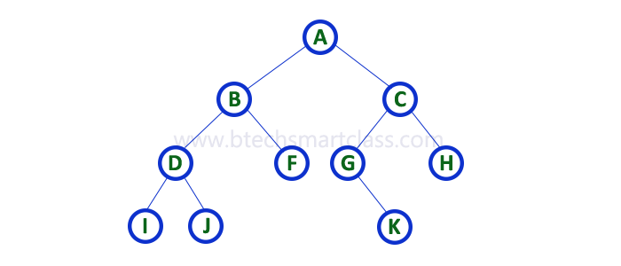

Non-linear Data Structures-Trees
Sequential representation
To represent a binary tree of depth ‘d' using array representation, we need one dimensional array with a maximum size of 2d+1 - 1.

Slide 47
Non-linear Data Structures-Trees
Sequential representation
Advantages:
Direct access to all nodes (Random access)
Disadvantages:
Height of tree should be known
Memory may be wasted
Insertion and deletion of a node is difficult

Slide 48

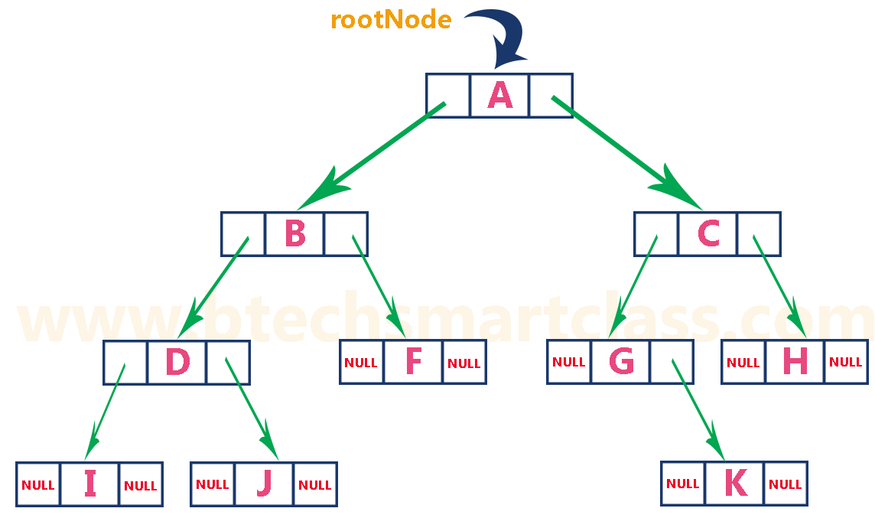
Non-linear Data Structures-Trees
List representation
struct node
{
int data;
struct node *left;
struct node *right;
}

Slide 49
Non-linear Data Structures-Trees
List representation
Advantages:
Height of tree need not be known
No memory wastage
Insertion and deletion of a node is done without affecting other nodes
Disadvantages:
Direct access to node is difficult
Additional memory required for storing address of left and right node

Slide 50
Non-linear Data Structures-Trees
Threaded representation
Binary trees have a lot of wasted space: the leaf nodes each have 2 null pointers.
We can use these pointers to help us in inorder traversals.
We have the pointers reference the next node in an inorder traversal; called threads.
We need to know if a pointer is an actual link or a thread, so we keep a boolean for each pointer.
A left NULL pointer can be used to store the address of inorder predecessor of the node.
A right NULL pointer can be used to store the address of inorder successor of the node.
These pointers are called threads and a binary tree which implements these pointers is called a Threaded Binary Tree.

Slide 51
Non-linear Data Structures-Trees
struct Node
{
Node left, right;
boolean leftThread, rightThread;
}
6
8
3
1
5
7
11
9
13

Slide 52
Non-linear Data Structures-Trees
Self Assessment Question
4. Which binary tree points to higher nodes in the tree.
Info
Root
Threads
Child
Answer: c)
Notes:
4. c)

Slide 53
Non-linear Data Structures-Trees
5. What are the advantages of linked list representation of binary trees over arrays?
a) dynamic size b) ease of insertion/deletion c) ease in randomly accessing a node d) both dynamic size and ease in insertion/deletion
Answer: d)
Notes:
5. d)

Slide 54
Non-linear Data Structures-Trees
Document Links
Topics | URL | Notes
Binary Tree representation (Sequential and Link) | https://www.includehelp.com/data-structure-tutorial/binary-tree-representation.aspx | This link explains about the representation of binary tree. What are the different representations of trees in the memory? What is linked list representation of binary tree? What is sequential representation of binary tree?
Threaded Binary Tree | https://www.geeksforgeeks.org/threaded-binary-tree/ | In this link, you will learn about the threaded binary trees its representation and its different types .

Slide 55
Non-linear Data Structures-Trees
Video Links
Topics | URL | Notes
Binary Tree representation (Sequential and Link) | https://www.tutorialspoint.com/data_structure/binary_tree_representation_in_memory.asp | This video explains about the representation of binary tree. What are the different representations of trees in the memory? What is linked list representation of binary tree? What is sequential representation of binary tree?
Threaded Binary Tree | https://www.youtube.com/watch?v=Gbrx1E8Cqkk | In this Video, you will learn about the threaded binary trees its representation and its different types

Slide 56
Non-linear Data Structures-Trees
CONVERSION FROM GENERAL TREES TO BINARY TREES

Slide 57
Non-linear Data Structures-Trees
General Trees
Trees in which the number of subtrees of any node need not be required to be 0, 1, or 2.
The number of subtrees for any node may be variable.
Some nodes may have 1 or no subtrees, others may have 3, some 4, or any other combination.
Ternary tree – 3 subtrees per node.

Slide 58
Non-linear Data Structures-Trees
Problems with General Trees and Solutions
Problems
The number of references for each node must be equal to the maximum that will be used in the tree.
Most of the algorithms for searching, traversing, adding and deleting nodes become much more complex in that they must now cope with situations where there are not just two possibilities for any node but multiple possibilities.
Solution
General trees can be converted to binary trees.
The algorithms that are used for binary tree processing can be used with minor modifications.

Slide 59
Non-linear Data Structures-Trees
Creating a Binary Tree from a General Tree
Conversion process
Use the root of the general tree as the root of the binary tree.
Determine the first child of the root. This is the leftmost node in the general tree at the next level.
Insert this node. The child reference of the parent node refers to this node.
Continue finding the first child of each parent node and insert it below the parent node with the child reference of the parent to this node.
When no more first children exist in the path just used, move back to the parent of the last node entered and repeat the above process.

Slide 60
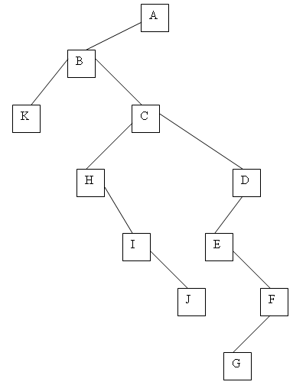
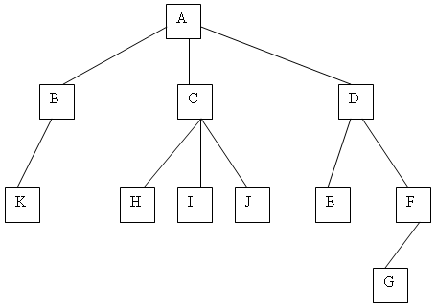
Non-linear Data Structures-Trees
Complete the tree for all nodes. In order to locate where the node fits, you must search for the first child at that level and then follow the sibling references to a nil where the next sibling can be inserted. The children of any sibling node can be inserted by locating the parent and then inserting the first child. Then the above process is repeated.
General Tree Binary Tree

Slide 61
Non-linear Data Structures-Trees
Self Assessment Question
6. Every tree can be uniquely represented as a binary tree. State whether true or false.
True
False
Answer: a)
Notes:
6. a)

Slide 62
Non-linear Data Structures-Trees
Document Links
Topics | URL | Notes
General tree to Binary tree | https://pages.cpsc.ucalgary.ca/~marina/335/Btree2.doc | This link explains about conversion process of general tree to binary tree

Slide 63
Non-linear Data Structures-Trees
Video Links
Topics | URL | Notes
Conversion | https://www.youtube.com/watch?v=bnN_Kor0MEA | This video explains about conversion process fo general tree to binary trees.

Slide 64
Non-linear Data Structures-Trees
APPLICATION
OF TREES

Slide 65
Non-linear Data Structures-Trees
Binary tree for an arithmetic expression
internal nodes: operators
leaves: operands
Example: arithmetic expression tree for the expression
((2  (5 - 1)) + (3  2))
+
×
×
2
−
3
2
5
1

Slide 66
Non-linear Data Structures-Trees
inorder traversal:
print “(“ before traversing left subtree
print operand or operator when visiting node
print “)“ after traversing right subtree
+
void printTree(t)
//binary operands only
if (t.left != null) print("(");
printTree (t.left);
print(t.element );
if (t.right != null)
printTree (t.right);
print (")");
×
×
2
−
3
2
5
1
((2 × (5 - 1)) + (3 × 2))

Slide 67
Non-linear Data Structures-Trees
Postorder traversal
Recursively evaluate subtrees
Apply the operator after subtrees are evaluated
+
int evaluate (t)
//binary operators only
if (t.left == null) //external node return t.element;
else //internal node
x = evaluate (t.left);
y = evaluate (t.right);
let o be the operator t.element
z = apply o to x and y
return z;
×
×
2
−
3
2
5
1

Slide 68
Non-linear Data Structures-Trees
Self Assessment Question
7. ___________ traversal is used to get infix notation from an expression tree.
Pre order
Post order
In order
Level order
Answer: c)
Notes:
7. c)

Slide 69
Non-linear Data Structures-Trees
8. __________ data structure is used to store hierarchical information.
Tree
Table
Stack
Array
Answer: a)
Notes:
8. a)

Slide 70
Non-linear Data Structures-Trees
Document Links
Topics | URL | Notes
Application of trees | https://www.geeksforgeeks.org/applications-of-tree-data-structure/ | This link explains about application of trees

Slide 71
Non-linear Data Structures-Trees
Video Links
Topics | URL | Notes
Application of trees | https://www.youtube.com/watch?v=OJ5NYq1Eii8 | This video explains about application of trees

Slide 72
Non-linear Data Structures-Trees
AVL TREES AND ROTATIONS

Slide 73
Non-linear Data Structures-Trees
AVL trees
It is a binary search tree that uses modified add and remove operations to stay balanced as its elements change
one of several kinds of auto-balancing trees (others in book)
invented in 1962 by two Russian mathematicians
(Adelson-Velskii and Landis)
A-V & L proved that an AVL tree's height is always O(log N).
basic idea: When nodes are added to / removed from the tree, if the tree becomes unbalanced, repair the tree until balance is restored
rebalancing operations are relatively efficient (O(1))
overall tree maintains a balanced O(log N) height, fast to add/search

Slide 74
Non-linear Data Structures-Trees
Balance factor
balance factor, for a tree node T :
= height of T's right subtree minus height of T's left subtree.
BF(T) = Height(T.right) - Height(T.left)
(the tree at right shows BF of each node)
an AVL tree maintains a "balance factor" in each node of 0, 1, or -1
i.e. no node's two child subtrees differ in height by more than 1
it can be proven that the height of an AVL tree with N nodes is O(log N)
-2
3
1
-2
0
-1
0

Slide 75
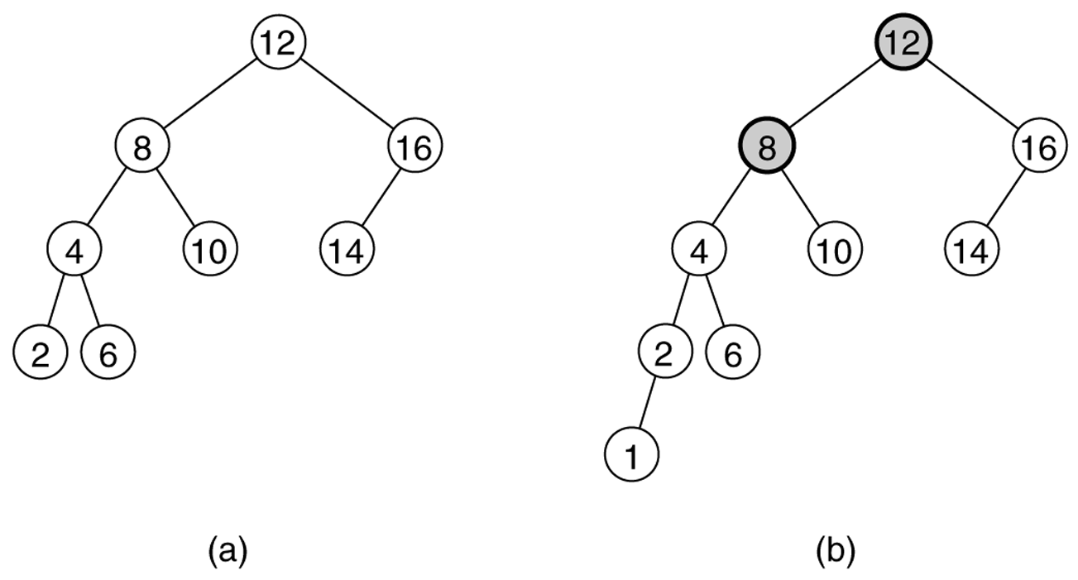
Non-linear Data Structures-Trees
AVL tree examples
Two binary search trees:
an AVL tree
not an AVL tree (unbalanced nodes are darkened)

Slide 76
Non-linear Data Structures-Trees
Which are valid AVL trees?
What is the balance factor of each tree node?
14
5
4
9
28
2
7
2
5
6
9
31
4
-1
8
4
20
44
3
-2
3
3
0
15
22
-4
1
11
33

Slide 77
Non-linear Data Structures-Trees
Tracking subtree height
Many of the AVL tree operations depend on height.
Height can be computed recursively by walking the tree; too slow.
Instead, each node can keep track of its subtree height as a field:
Struct TreeNode {
E data;
int height;
TreeNode left;
TreeNode right;
}
10
data
4
4
height
10
left/ right
3
2
5
20
1
2
1
1
2
9
15
30
1
7

Slide 78
Non-linear Data Structures-Trees
Rotations
If a node has become out of balanced in a given direction, rotate it in the opposite direction.
Rotation: A swap between parent and left or right child, maintaining proper BST ordering.
25
8
rotate right
8
3
25
3
11
11

Slide 79
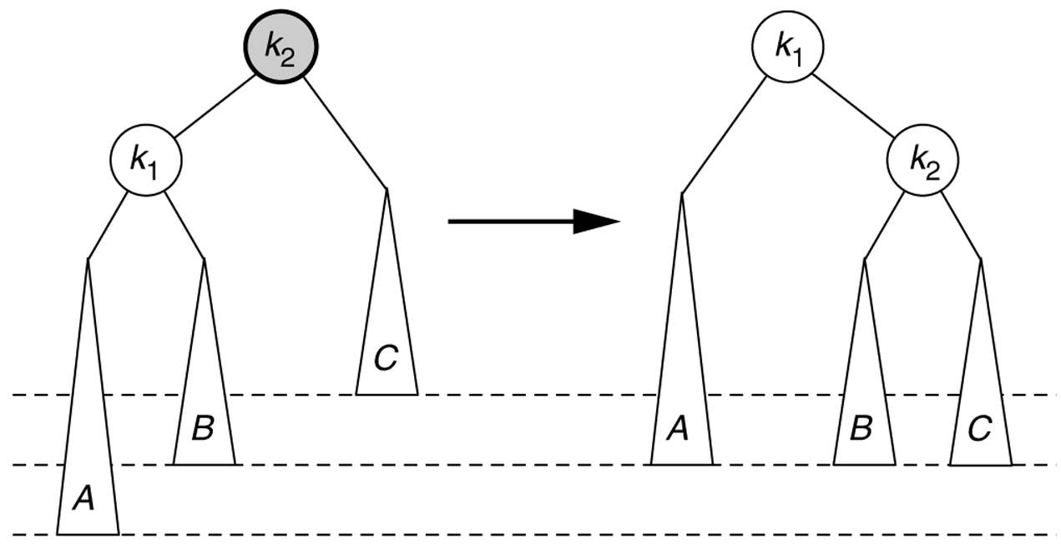
Non-linear Data Structures-Trees
Right rotation
right rotation (clockwise):
left child k1 becomes parent
original parent k2 demoted to right
k1's original right subtree B (if any) is attached to k2 as left subtree

Slide 80
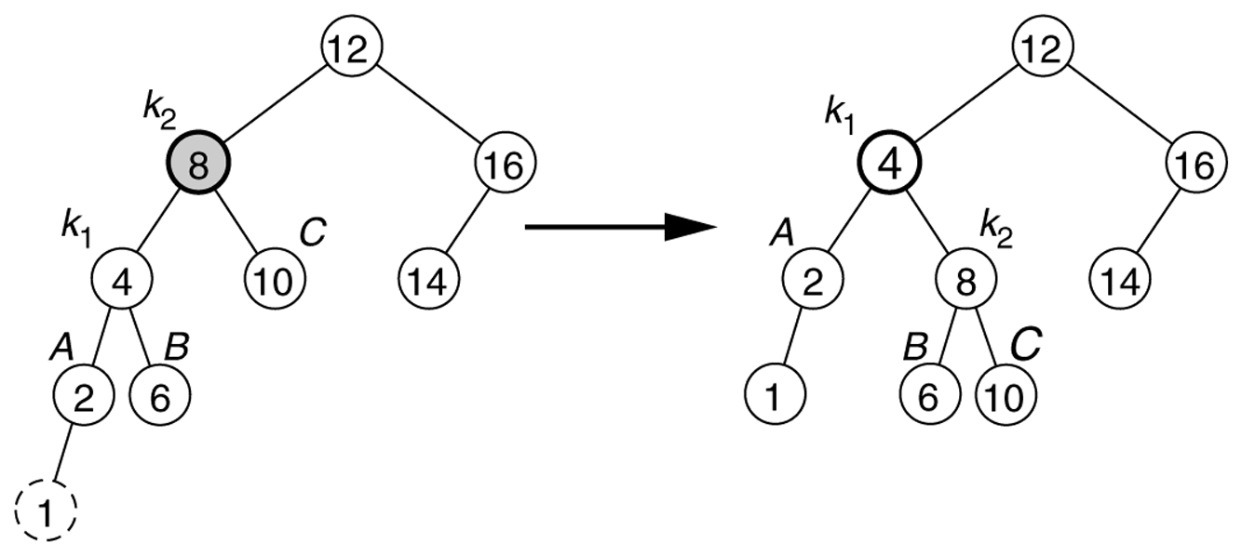
Non-linear Data Structures-Trees
Right rotation example

Slide 81
Non-linear Data Structures-Trees
Right rotation steps
Detach left child (11)'s right subtree (27) (don't lose it!).
Consider left child (11) be the new parent.
Attach old parent (43) onto right of new parent (11).
Attach new parent (11)'s old right subtree (27) as left subtree of old parent (43).
43
43
11
11
65
11
65
8
43
8
27
8
27
3
27
65
3
3

Slide 82
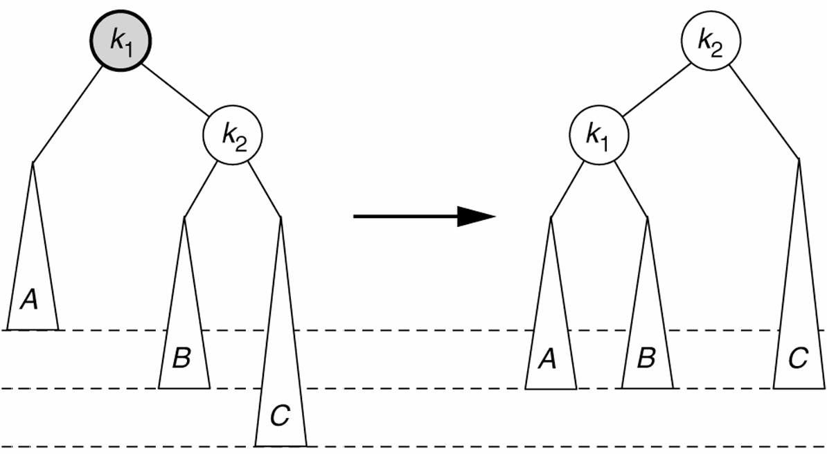
Non-linear Data Structures-Trees
Left rotation
left rotation (counter-clockwise):
right child k2 becomes parent.
original parent k1 demoted to left.
k2's original left subtree B (if any) is attached to k1 as left subtree.

Slide 83
Non-linear Data Structures-Trees
Left rotation steps
Detach right child (65)'s left subtree (51) (don't lose it!).
Consider right child (65) be the new parent.
Attach old parent (43) onto left of new parent (65).
Attach new parent (65)'s old left subtree (51) as right subtree of old parent (43).
43
43
65
21
65
65
21
43
87
51
87
51
87
21
51
73
73
73

Slide 84
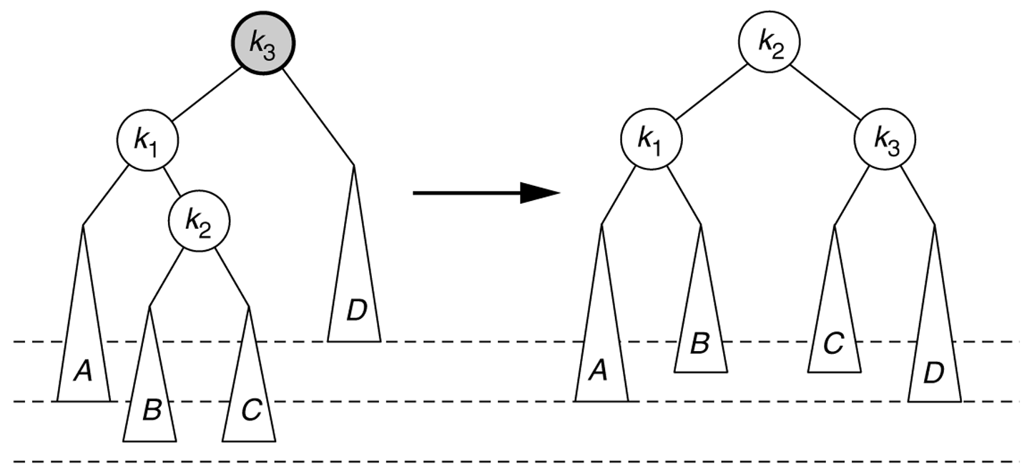
Non-linear Data Structures-Trees
Left-right double rotation
left-right double rotation:
left-rotate k3's left child ... reduces Case 2 into Case 1
right-rotate k3 to fix Case 1

Slide 85
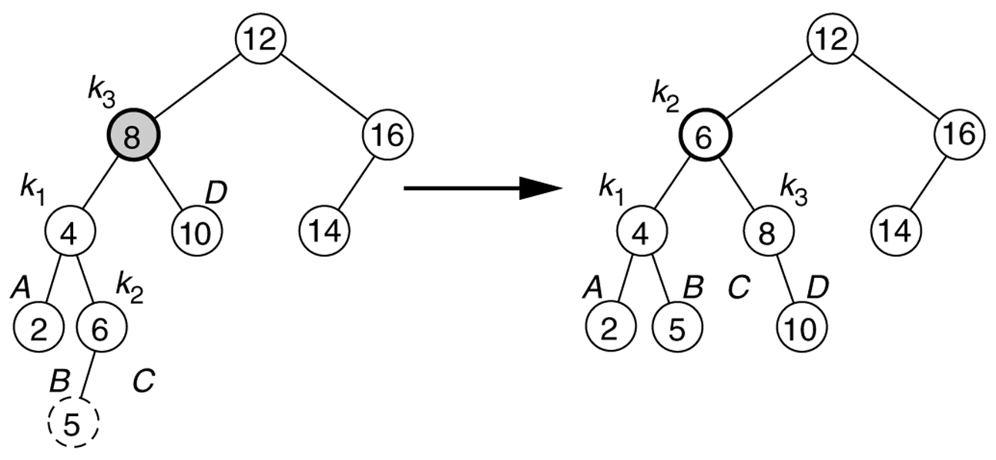
Non-linear Data Structures-Trees
Left-right rotation example

Slide 86
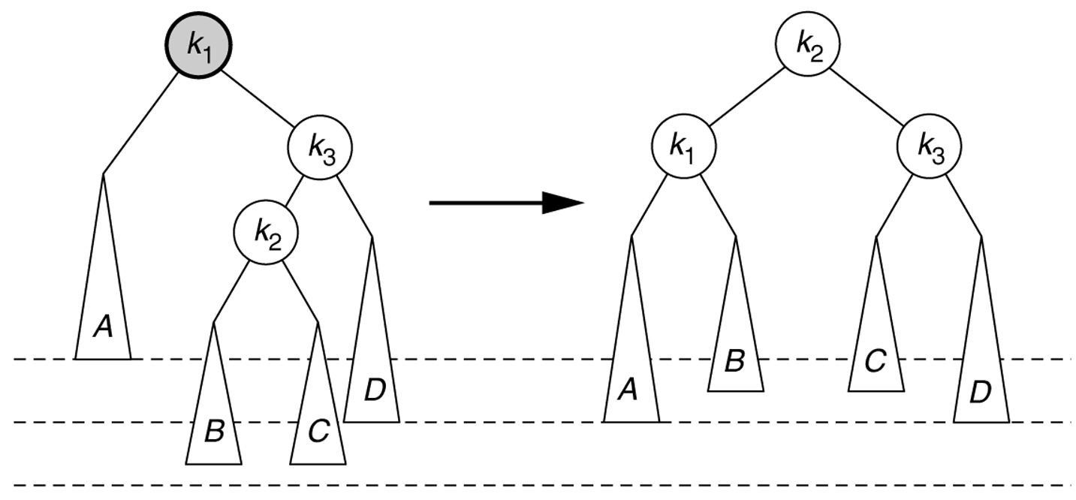
Non-linear Data Structures-Trees
Right-left double rotation
left-right double rotation:
right-rotate k1's right child
left-rotate k1

Slide 87
Non-linear Data Structures-Trees
Self Assessment Question
What is the maximum height of any AVL-tree with 7 nodes? Assume that the height of a tree with a single node is 0.
2
3
4
5
Answer: b)
Notes:
9. b)

Slide 88
Non-linear Data Structures-Trees
What is the worst case possible height of AVL tree?
2*log n
1.44*log n
Depends upon implementation
θ(n)
Answer: b)
Notes:
10. b)

Slide 89
Non-linear Data Structures-Trees
Assignments
For all program or data structure design problems such as the two below you must provide pseudocode (see the manual) and an adequate explanation of the methods. It is often helpful to include small examples demonstrating the methods. Straight pseudocode with no additional documentation is not enough.
In this problem you will design a recursive AVL deletion procedure and execute it on a simple example.
Design a recursive AVL tree deletion procedure. You may assume that rotation and height calculation procedures are available to you. Your procedure should be modeled on the recursive deletion procedure on page 115 of the text. After each recursive call and before returning, rotations must be done to rebalance the tree.

Slide 90
Non-linear Data Structures-Trees
In this problem you will demonstrate how splay tree insertion and deletion work on the example tree above.
Insert 8 into the tree above. Show the tree after each rotation and double rotation.
Delete 10 from the tree above. Show the tree after each rotation and double rotation.

Slide 91
Non-linear Data Structures-Trees
Document Links
Topics | URL | Notes
AVL TREES AND ROTATIONS | https://www.tutorialspoint.com/data_structures_algorithms/avl_tree_algorithm.htm | This link explains about AVL trees and rotations

Slide 92
Non-linear Data Structures-Trees
Video Links
Topics | URL | Notes
AVL TREES AND ROTATIONS | https://www.youtube.com/watch?v=4UfekZU9fZw | This video explains about AVL trees and rotations

Slide 93
Non-linear Data Structures-Trees
E-Book Links
Topics | URL | Notes
TREES | fZwhttp://masterraghu.com/subjects/Datastructures/ebooks/rema%20thareja.pdf | This eBook is useful for studying about trees

